Slide 1
Measuring Cluster Goodness

Slide 2
Rational for Measuring Cluster Goodness
Do clusters correspond to reality or are they simply artifacts of mathematical convenience?
What are the optimal number of cluster to identify?
How do I measure wheather one set of clusters is preferable to another?
The silhouette method and the pseudo-F statistic will help us address these questions by measuring cluster goodness

Slide 3
Concepts Measures Should Address
Cluster separation represents how distant the clusters are from each other
Cluster cohesion refers to how tightly related the records within the individual clusters are
Good measures should incorporate both as do the silhouette and pseudo-F statistic
However, the sum of squares error (SSE) only accounts for cluster cohesion and is monotonically decreasing with increasing numbers of clusters

Slide 4
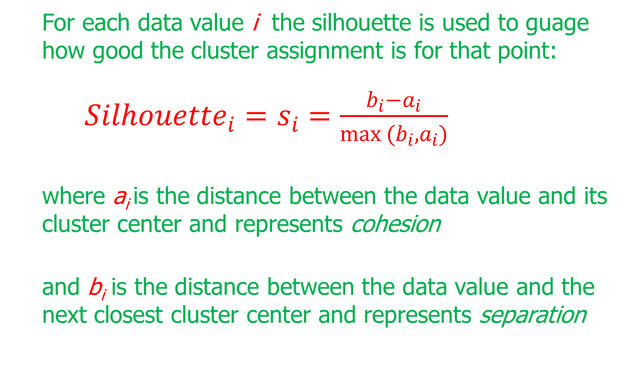
The Silhouette Method
For each data value i the silhouette is used to guage how good the cluster assignment is for that point:
${Silhouette}_{i}=s_{i}=\frac{b_{i}−a_{i}}{max (b_{i}, a_{i})}$
where a_{i} is the distance between the data value and its cluster center and represents cohesion
and b_{i} is the distance between the data value and the next closest cluster center and represents separation

Slide 5
The Silhouette Method (cont.)
A positive value indicates that the assignment is good, with higher values better than lower values
A value close to zero is considered to be weak since the observation could have been assigned to the next cluster with little negative consequence
A negative value is considered to be misclassified since assignment to the next closest cluster would have been better

Slide 6
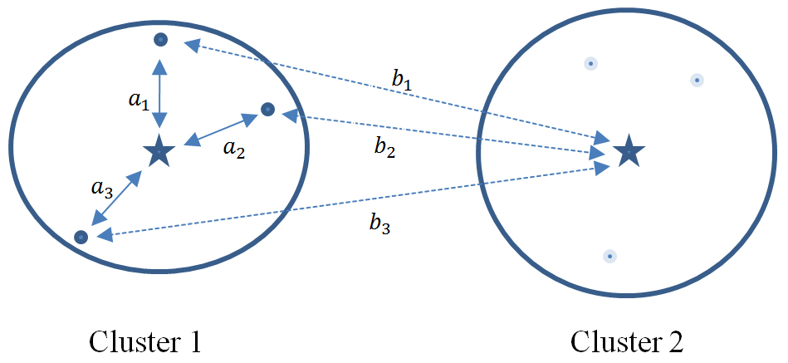
Silhouette Accounts for Separation & Cohesion
Each data value in Cluster 1 has its values of a_{i} and b_{i} represented by solid and dotted lines, respectively
b_{i} > a_{i} for each data value, thus each data value’s silhouette is positive, indicating the data are not misclassified

Slide 7
The Average Silhouette Value
The average silhouette value over all records yields a measure of how well the cluster solution fits. A thumbnail interpretation, meant as a guide only:
0.5 or better provides good evidence of the reality of the clusters in the data
0.25 – 0.5 provides some evidence of the reality of the clusters in the data.
Less than 0.25 provides scant evidence of cluster reality

Slide 8
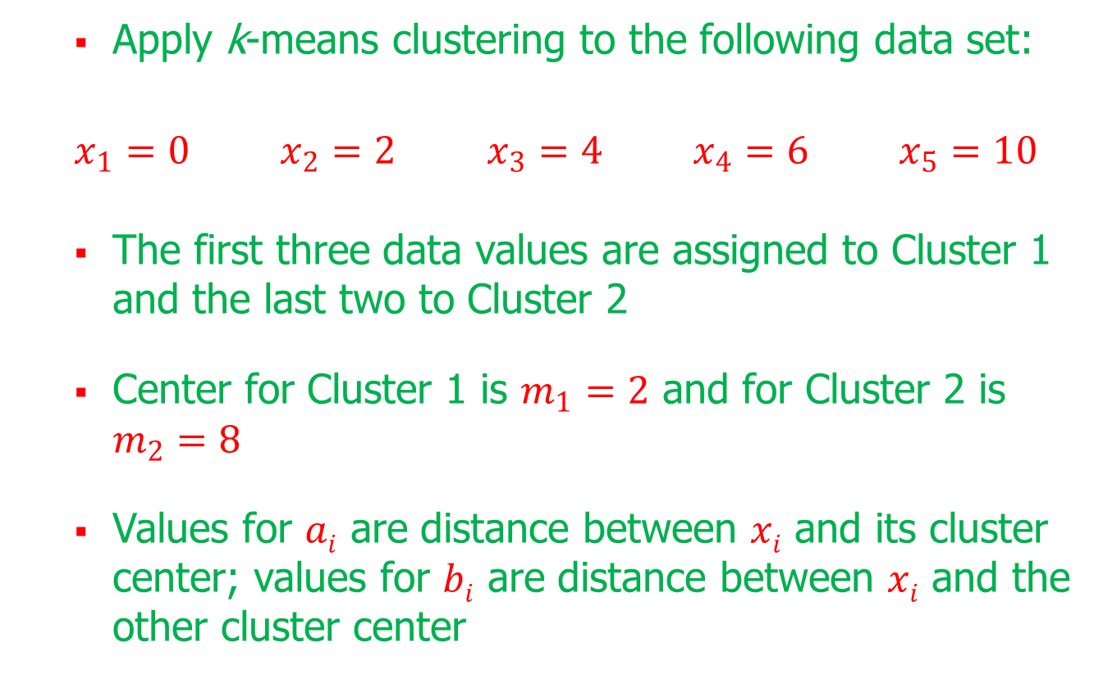
Silhouette Example (cont.)
Apply k-means clustering to the following data set:
$x_{1}=0$ $x_{2}=2$ $x_{3}=4$ $x_{4}=6$ $x_{5}=10$
The first three data values are assigned to Cluster 1 and the last two to Cluster 2
Center for Cluster 1 is $m_{1}=2$ and for Cluster 2 is $m_{2}=8$
Values for $ai$ are distance between $xi$ and its cluster center; values for $bi$ are distance between $xi$ and the other cluster center

Slide 9
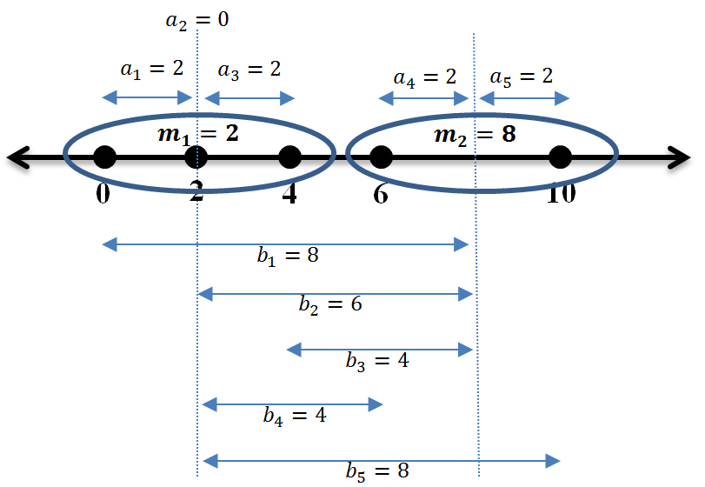
Silhouette Example (cont.)
Distances between the data values and cluster centers:

Slide 10
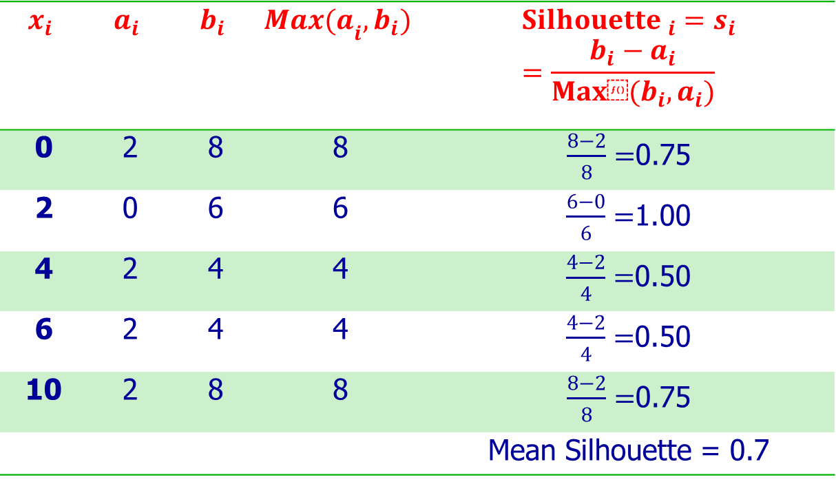
Silhouette Example (cont.)
Calculations for individual data values:
$$x_{i}$$ | $$a_{i}$$ | $$b_{i}$$ | $${Max(a}_{i},b_{i})$$ | $${Silhouette }_{i}=s_{i}=\frac{b_{i}−a_{i}}{Max⁡(b_{i}, a_{i})}$$
0 | 2 | 8 | 8 | $\frac{8−2}{8}=$0.75
2 | 0 | 6 | 6 | $\frac{6−0}{6}=$1.00
4 | 2 | 4 | 4 | $\frac{4−2}{4}=$0.50
6 | 2 | 4 | 4 | $\frac{4−2}{4}=$0.50
10 | 2 | 8 | 8 | $\frac{8−2}{8}=$0.75
 |  |  |  | Mean Silhouette = 0.7

Slide 11
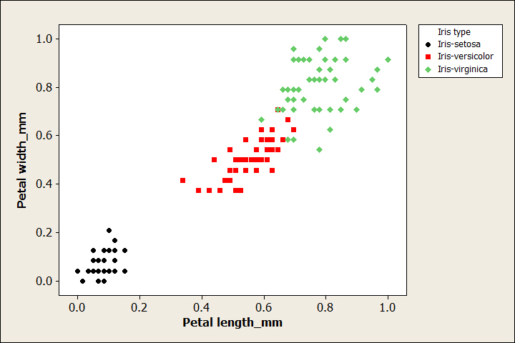
Silhouette Analysis of Iris Data
Scatterplot of petal width vs. petal length by species, where two of the species seem to blend into one another

Slide 12
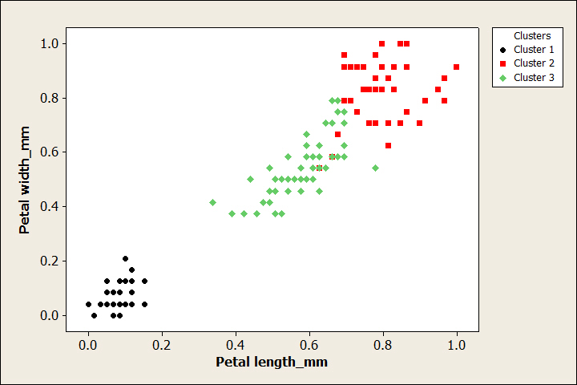
Silhouette Analysis of Iris Data (cont.)
Results of k=3 k-means clustering do not match perfectly with species:

Slide 13
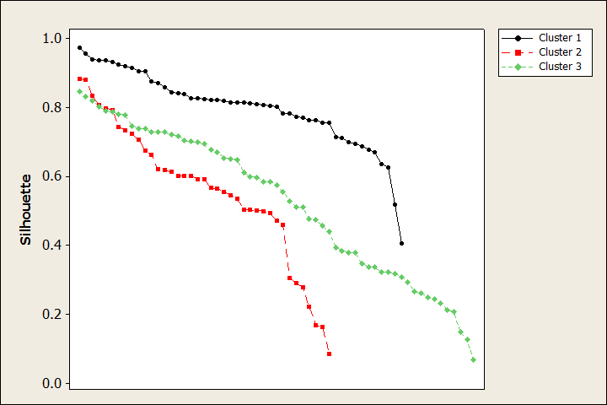
Silhouette Analysis of Iris Data (cont.)
Values of silhouette for each flower calculated and shown sorted from highest to lowest for each cluster:

Slide 14
Silhouette Analysis of Iris Data (cont.)
Cluster 1 is the best defined with most values rather high
Clusters 2 and 3 have some high and some low values
The mean silhouette values for each cluster suggest that Cluster 1 is well defined, and that Clusters 2 and 3 are not so well defined:
 | Cluster 1 | Cluster 2 | Cluster 3 | Overall
Mean Silhouette | 0.8002 | 0.5593 | 0.5254 | 0.6258

Slide 15
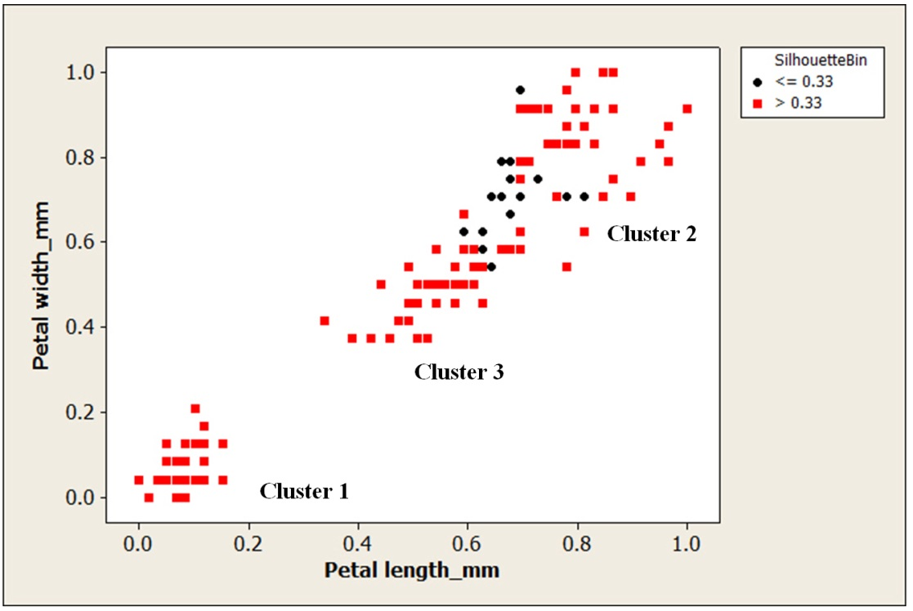
Silhouette Analysis of Iris Data (cont.)
Low silhouette values come from the boundary area between Clusters 2 and 3:

Slide 16
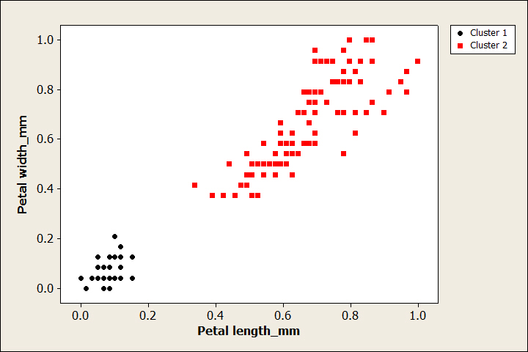
Silhouette Analysis of Iris Data (cont.)
Results of k=2 k-means clustering combine the Versicolor and Virginica into a single cluster:

Slide 17
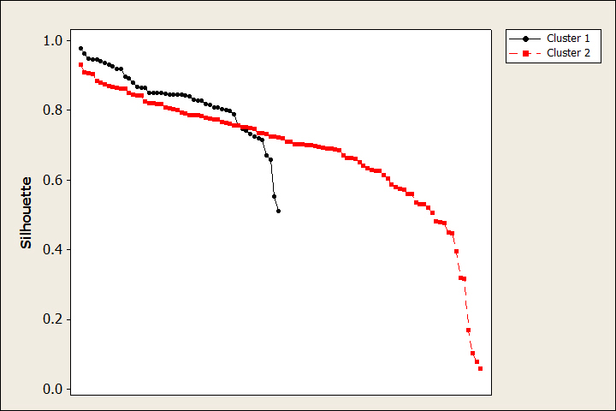
Silhouette Analysis of Iris Data (cont.)
The silhouette plot has fewer lower values than for k=3 and higher mean values
 | Cluster 1 | Cluster 2 | Overall
Mean Silhouette | 0.8285 | 0.6838 | 0.7321

Slide 18
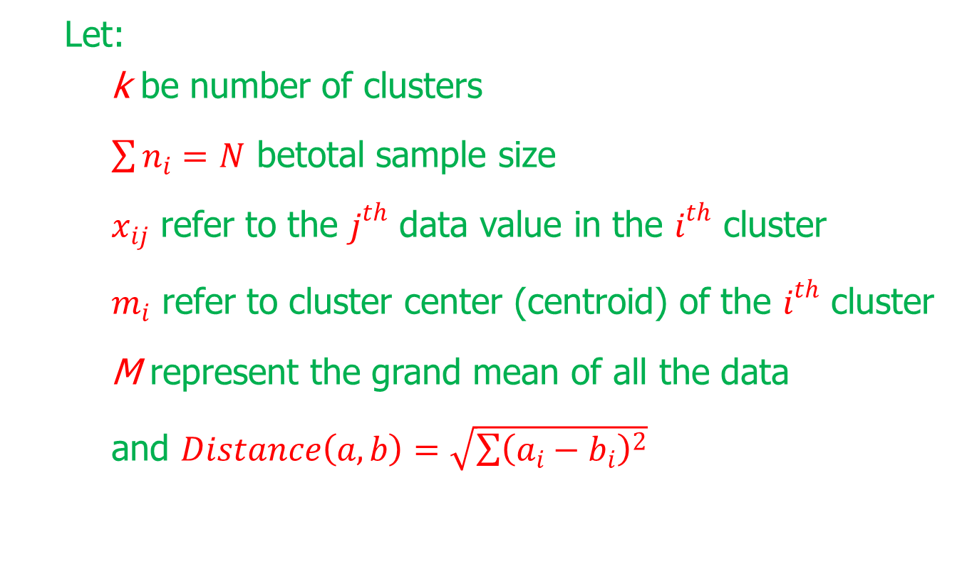
The pseudo-F Statistic
Let:
k be number of clusters
$\sum{n_{i}=N}$ betotal sample size
$x_{ij}$ refer to the $j^{th}$ data value in the $i^{th}$ cluster
$m_{i}$ refer to cluster center (centroid) of the $i^{th}$ cluster
M represent the grand mean of all the data
and $Distance\left(a,b\right)=\sqrt{\sum{{\left(a_{i}−b_{i}\right)}^{2}}}$

Slide 19
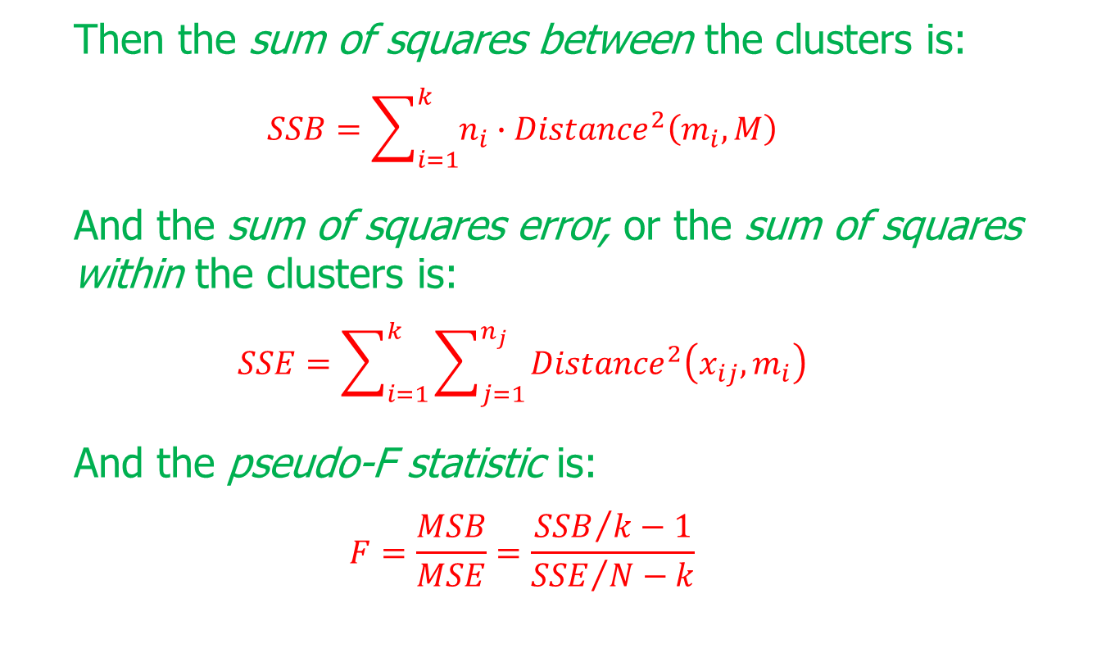
The pseudo-F Statistic (cont.)
Then the sum of squares between the clusters is:
$$SSB=\sum_{i=1}^{k}{n_{i}∙{Distance}^{2}\left(m_{i}, M\right)}$$
And the sum of squares error, or the sum of squares within the clusters is:
$$SSE=\sum_{i=1}^{k}{\sum_{j=1}^{n_{j}}{{Distance}^{2}\left(x_{ij},m_{i}\right)}}$$
And the pseudo-F statistic is:
$$F=\frac{MSB}{MSE}=\frac{{SSB}/{k−1}}{{SSE}/{N−k}}$$

Slide 20
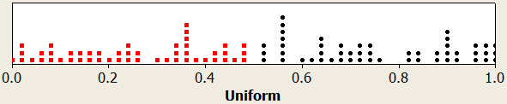
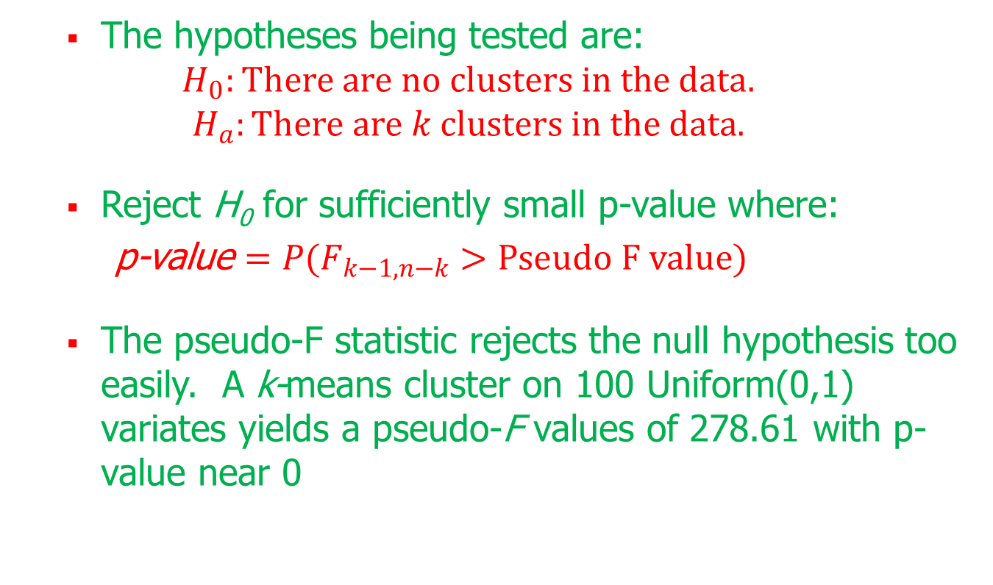
The pseudo-F Statistic (cont.)
The hypotheses being tested are:
$$H_{0}:There are no clusters in the data.$$
$$H_{a}:There are k clusters in the data.$$
Reject H₀ for sufficiently small p-value where:
p-value $=P(F_{k−1,n−k}>Pseudo F value)$
The pseudo-F statistic rejects the null hypothesis too easily. A k-means cluster on 100 Uniform(0,1) variates yields a pseudo-F values of 278.61 with p-value near 0

Slide 21
The pseudo-F Statistic (cont.)
The pseudo-F statistic should not be used to determine the presence of clusters but can be used to select the optimal number of clusters as follows:
Use a clustering algorithm to develop a clustering solution for a variety of values of k.
Calculate the pseudo-F statistic and p-value for each candidate, and select the candidate with the smallest p-value as the best clustering solution.

Slide 22
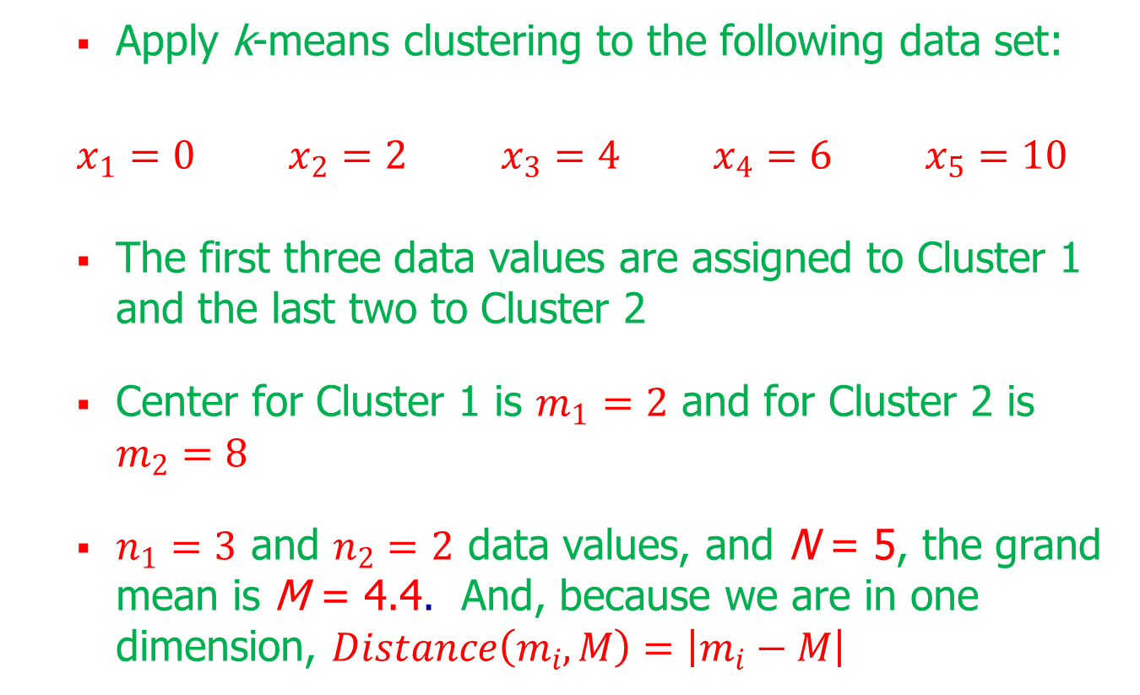
Pseudo-F Statistic Example
Apply k-means clustering to the following data set:
$x_{1}=0$ $x_{2}=2$ $x_{3}=4$ $x_{4}=6$ $x_{5}=10$
The first three data values are assigned to Cluster 1 and the last two to Cluster 2
Center for Cluster 1 is $m_{1}=2$ and for Cluster 2 is $m_{2}=8$
$n_{1}=3$ and $n_{2}=2$ data values, and N = 5, the grand mean is M = 4.4. And, because we are in one dimension, $Distance\left(m_{i}, M\right)=\left|m_{i}−M\right|$

Slide 23
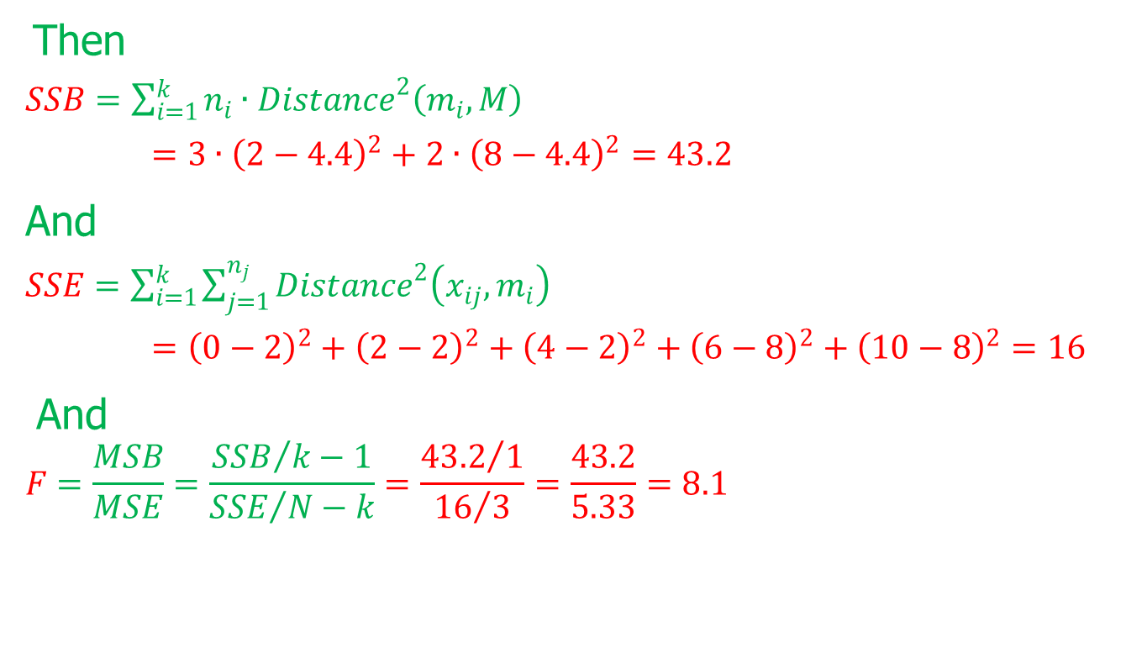
Pseudo-F Statistic Example (cont.)
Then
$SSB=\sum_{i=1}^{k}{n_{i}∙{Distance}^{2}\left(m_{i}, M\right)}$
$=3∙{\left(2−4.4\right)}^{2}+2∙{\left(8−4.4\right)}^{2}=43.2$
And
$SSE=\sum_{i=1}^{k}{\sum_{j=1}^{n_{j}}{{Distance}^{2}\left(x_{ij},m_{i}\right)}}$
$={\left(0−2\right)}^{2}+{\left(2−2\right)}^{2}+{\left(4−2\right)}^{2}+{\left(6−8\right)}^{2}+{\left(10−8\right)}^{2}=16$
And
$$F=\frac{MSB}{MSE}=\frac{{SSB}/{k−1}}{{SSE}/{N−k}}=\frac{{43.2}/1}{{16}/3}=\frac{43.2}{5.33}=8.1$$

Slide 24
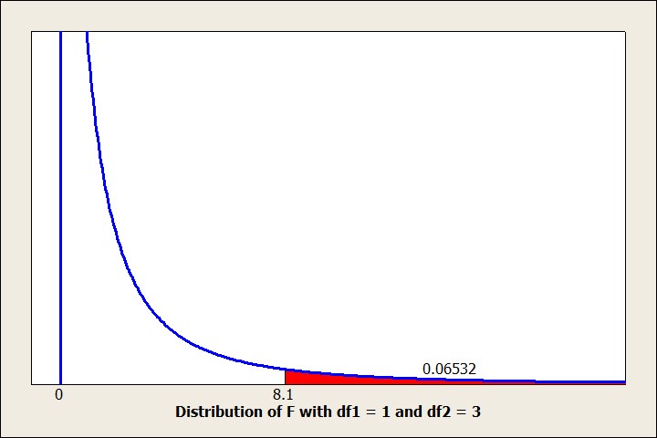
Pseudo-F Statistic Example (cont.)
Distribution of the F statistic shows tht p-value of 0.06532 does not indicate strong evidence of clusters:

Slide 25
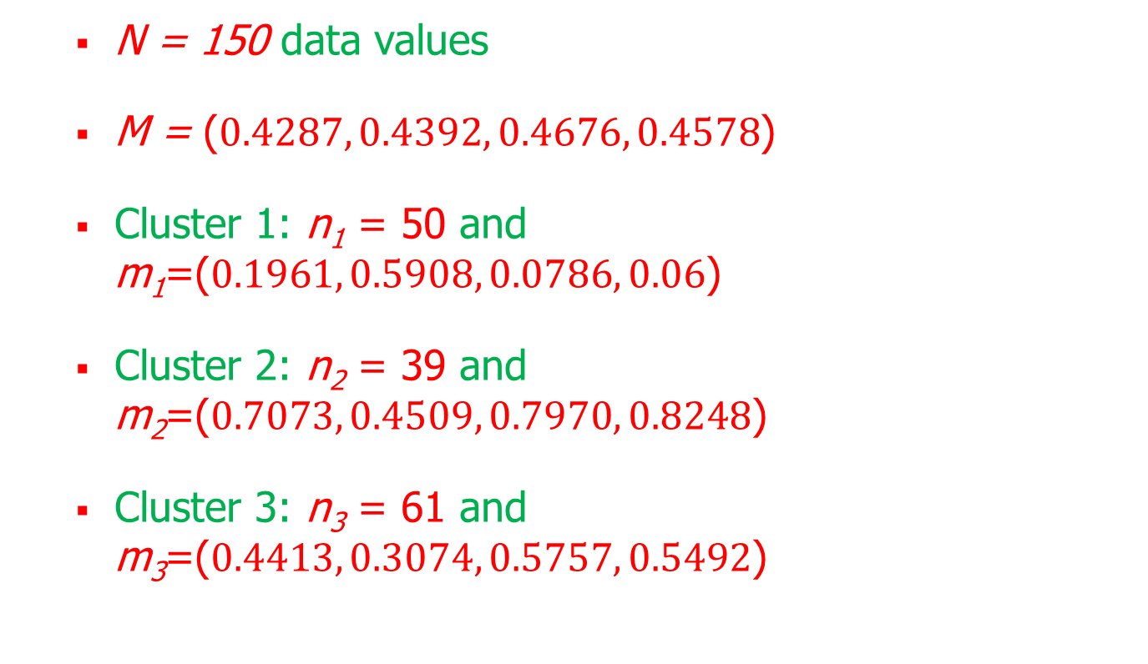
Pseudo-F Statistic Applied to Iris Data
N = 150 data values
M = ($0.4287, 0.4392, 0.4676, 0.4578$)
Cluster 1: n₁ = 50 and m₁=($0.1961, 0.5908, 0.0786, 0.06$)
Cluster 2: n₂ = 39 and m₂=($0.7073, 0.4509, 0.7970, 0.8248$)
Cluster 3: n₃ = 61 and m₃=($0.4413, 0.3074, 0.5757, 0.5492$)

Slide 26
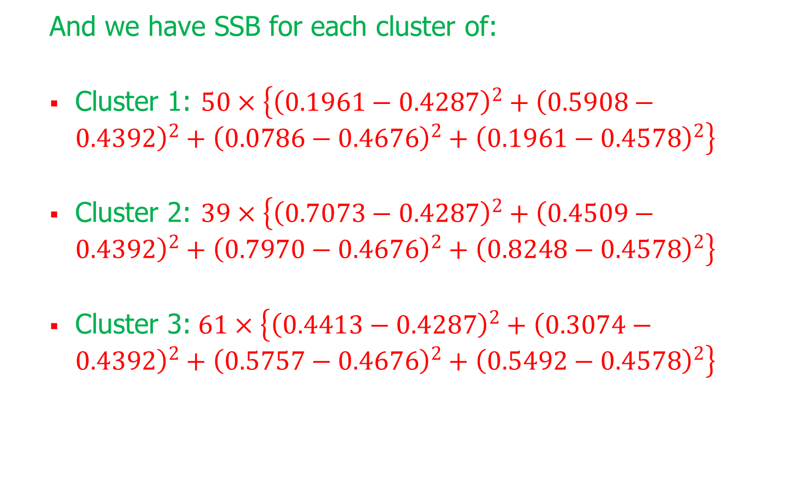
Pseudo-F Statistic Applied to Iris Data (cont.)
And we have SSB for each cluster of:
Cluster 1: $50×\left\{{\left(0.1961−0.4287\right)}^{2}+{\left(0.5908−0.4392\right)}^{2}+{\left(0.0786−0.4676\right)}^{2}+{\left(0.1961−0.4578\right)}^{2}\right\}$
Cluster 2: $39×\left\{{\left(0.7073−0.4287\right)}^{2}+{\left(0.4509−0.4392\right)}^{2}+{\left(0.7970−0.4676\right)}^{2}+{\left(0.8248−0.4578\right)}^{2}\right\}$
Cluster 3:$61×\left\{{\left(0.4413−0.4287\right)}^{2}+{\left(0.3074−0.4392\right)}^{2}+{\left(0.5757−0.4676\right)}^{2}+{\left(0.5492−0.4578\right)}^{2}\right\}$

Slide 27
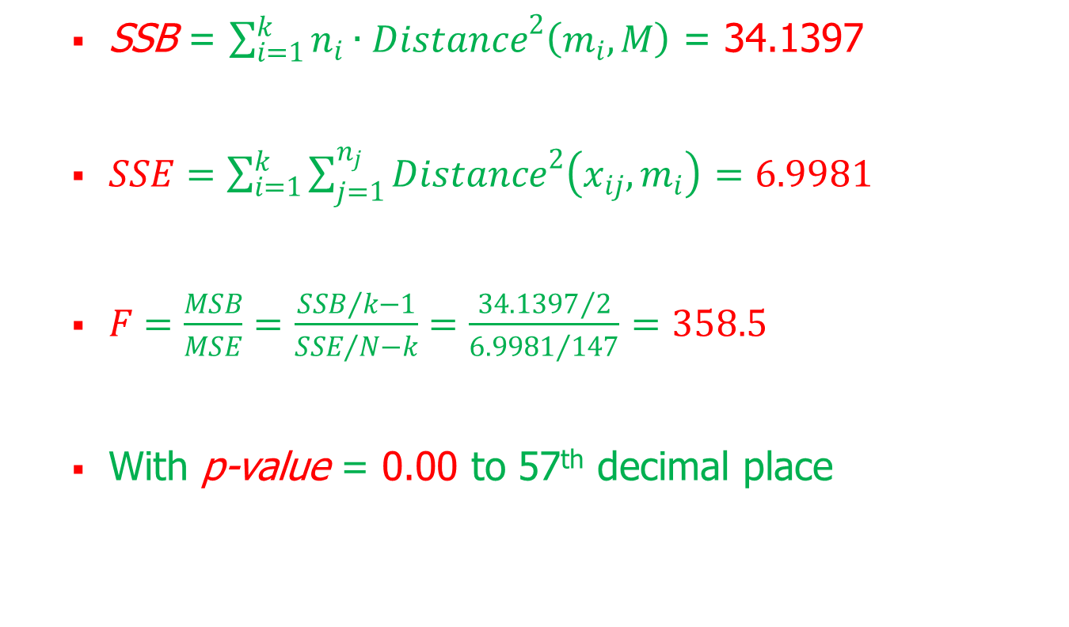
Pseudo-F Statistic Applied to Iris Data (cont.)
SSB = $\sum_{i=1}^{k}{n_{i}∙{Distance}^{2}\left(m_{i}, M\right)}$ = 34.1397
$SSE=\sum_{i=1}^{k}{\sum_{j=1}^{n_{j}}{{Distance}^{2}\left(x_{ij},m_{i}\right)}}$ $=6.9981$
$F=\frac{MSB}{MSE}=\frac{{SSB}/{k−1}}{{SSE}/{N−k}}=\frac{{34.1397}/2}{{6.9981}/{147}}=358.5$
With p-value = 0.00 to 57th decimal place

Slide 28
Cluster Validation
As with any other data mining modeling technique, cluster analysis should be subject to cross-validation to ensure the clusters are real
A simple graphical and statistical approach with the goal of confirming the clusters found in the test data match those in the training data is:
Apply cluster analysis to training data
Apply cluster analysis to test data
Use graphics and statistics to confirm the clusters in the training data match those in the test data

Slide 29
Cluster Validation – Loans Data
Bank loan approval analyst is using Loans data fields debt-to-income ratio, FICO score, and request amount to predict approval
k-means with k=3 was applied to each of the training and test data sets.
Cluster 1 is the smallest and contains high debt-to-income applicants with low FICO scores and low loan amounts
Cluster 2 contains moderate debt-to-income applicants with moderate/high FICO scores and high request amounts
Cluster 3 is the largest and contains low debt-to-income applicants with high FICO scores and low request amounts

Slide 30
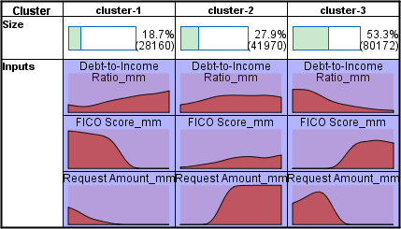
Cluster Validation – Loans Data (cont.)
Summary graphics of clusters generated on training data set:

Slide 31
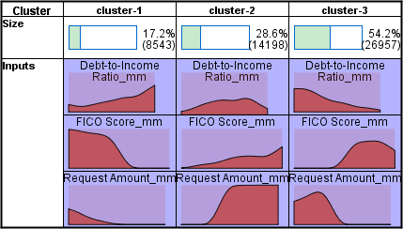
Cluster Validation – Loans Data (cont.)
Summary graphics of clusters generated on test data set:

Slide 32
Cluster Validation – Loans Data (cont.)
Summary statistics of clusters generated on training and test data sets:
Cluster 1 | Training | Test | Training | Test | Training | Test
 | DIR | DIR | FICO | FICO | Amount | Amount
Mean | 0.200 | 0.195 | 0.399 | 0.385 | 0.130 | 0.134
Stand. Dev. | 0.170 | 0.171 | 0.120 | 0.115 | 0.100 | 0.104
Records | 28,160 | 8543 | 28,160 | 8543 | 28,160 | 8543
Cluster 2 | Training | Test | Training | Test | Training | Test
 | DIR | DIR | FICO | FICO | Amount | Amount
Mean | 0.212 | 0.210 | 0.628 | 0.630 | 0.591 | 0.587
Stand. Dev. | 0.147 | 0.147 | 0.112 | 0.111 | 0.139 | 0.140
Records | 41,970 | 14,198 | 41,970 | 14,198 | 41,970 | 14,198
Cluster 3 | Training | Test | Training | Test | Training | Test
 | DIR | DIR | FICO | FICO | Amount | Amount
Mean | 0.153 | 0.156 | 0.664 | 0.662 | 0.202 | 0.196
Stand. Dev. | 0.102 | 0.107 | 0.076 | 0.077 | 0.105 | 0.103
Records | 80,172 | 26,957 | 80,172 | 26,957 | 80,172 | 26,957

Slide 33
Cluster Validation – Loans Data
Difference between variables with results from two-sample hypothesis test:
Practically all of the p-values are small; however, the null hypothesis is very easily rejected for very large sample sizes making it of limited usefulness for big data applications
The analyst should concentrate on the big picture. The clusters are broadly similar, with similar profiles and variable means close to each other, thus we judge them validated
 | Cluster 1 |  |  | Cluster 2 |  |  | Cluster 3
 | DIR | FICO | Amt | DIR | FICO | Amt | DIR | FICO | Amt
Diff | 0.005 | 0.014 | –0.004 | 0.002 | –0.002 | 0.004 | –0.003 | 0.002 | 0.006
t-stat | 2.37 | 9.76 | –3.12 | 1.40 | –1.85 | 2.95 | –4.03 | 3.70 | 8.23
p-value | 0.018 | 0.000 | 0.002 | 0.161 | 0.064 | 0.003 | 0.000 | 0.000 | 0.000

